Slide 1


DATA SCIENCE PROJECT
Estimate the number of medical equipment required in covid-19 environment
SIMI SUDHAKARAN &
MIHIKA PATEL

Slide 2
About the Project
Description:
This estimation will be useful for healthcare providers and Government officials to estimate and prioritize the purchase of cardiac equipment in Covid-19 situation. Source of this dataset is from the National Cardiovascular disease surveillance data. For this project we will be concentrating specifically on Cardiovascular diseases. Although, this model can be replicated for any other diseases during a pandemic.
This particular dataset consist of data from all the states in USA from the timeframe 2011 to 2017. The 2020 data has not been published yet but we will predict it using the Linear regression model. We will also be clustering the state wise data using K-Mean clustering, so that we can prioritize the states which are at a higher risk and therefore require more medical equipment relative to other states.
Goal:
The main purpose of this project is to filter and analyze the estimated percentage of prevalence of heart disease which will in turn help in estimating the total cardiac devices required in a given region.
Assumptions:
We will be using the current estimated mortality rate of 51% in patients with pre-existing heart conditions as published by the Medical association of China & South Korea.

Slide 3
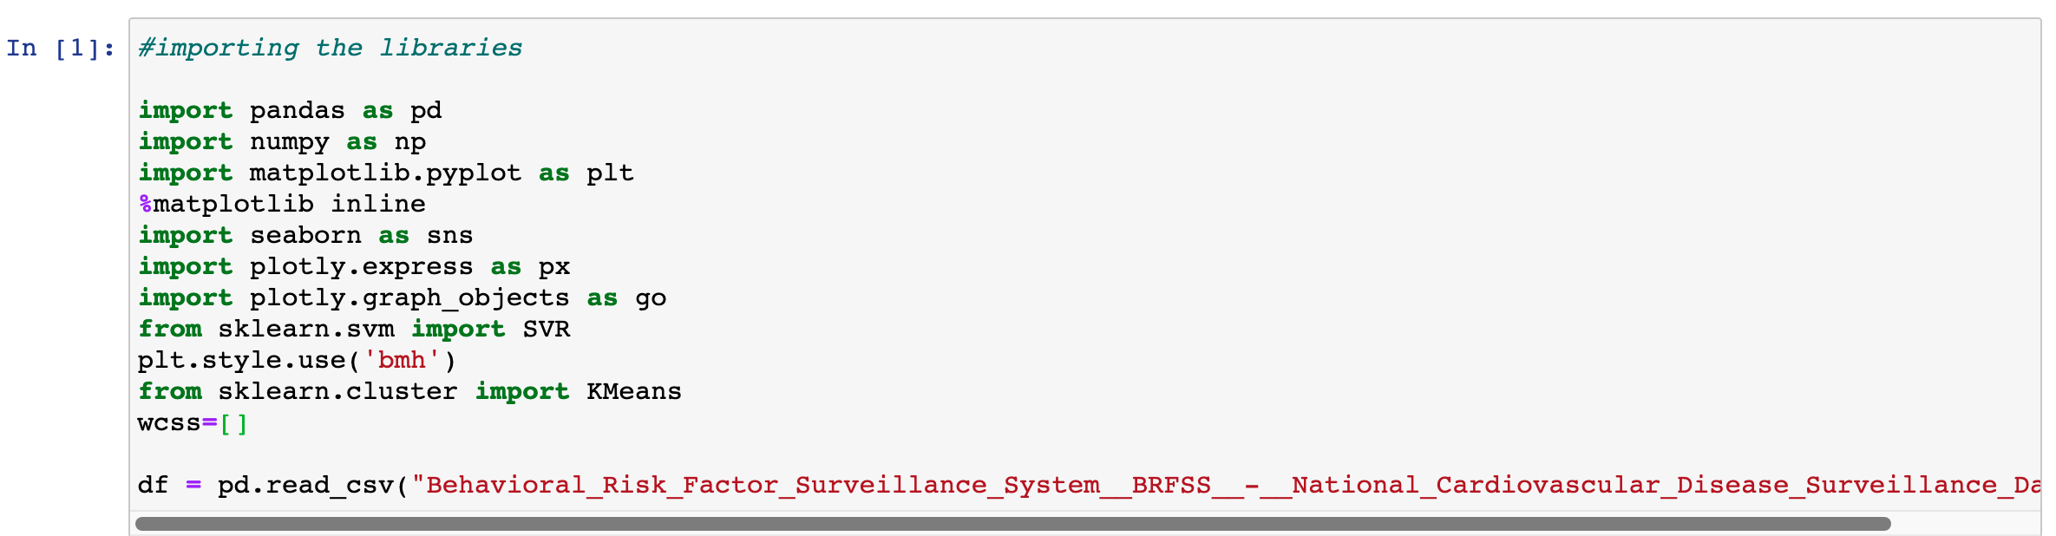
Imports and read the data

Slide 4
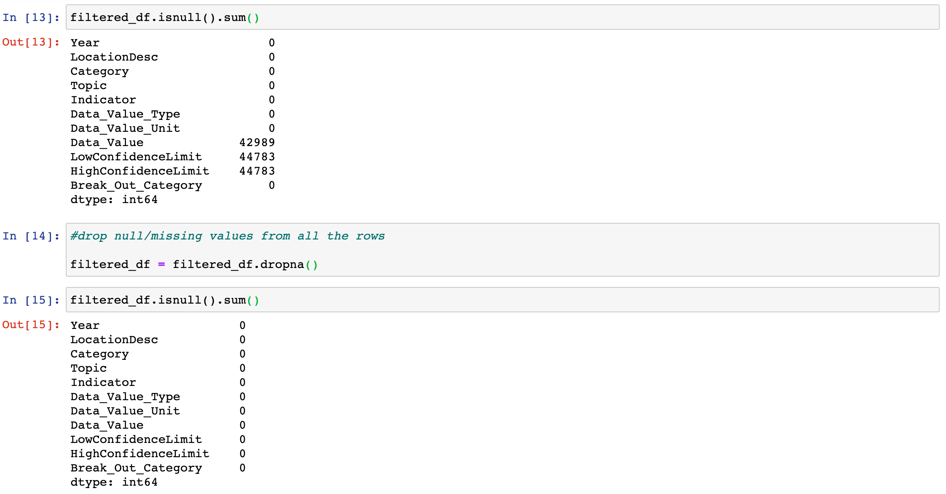
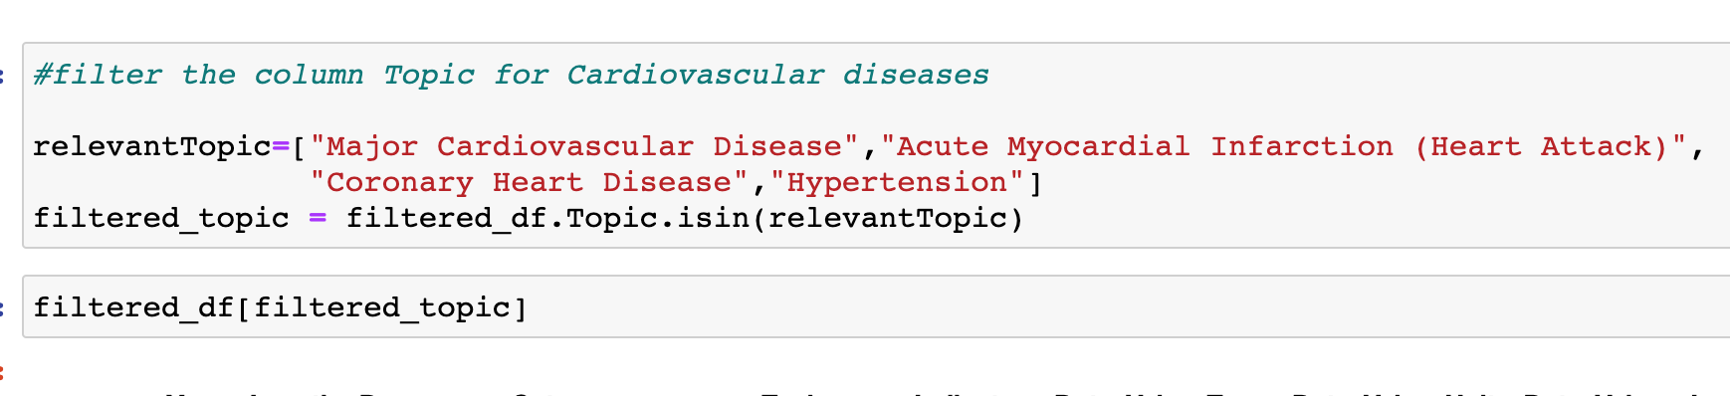
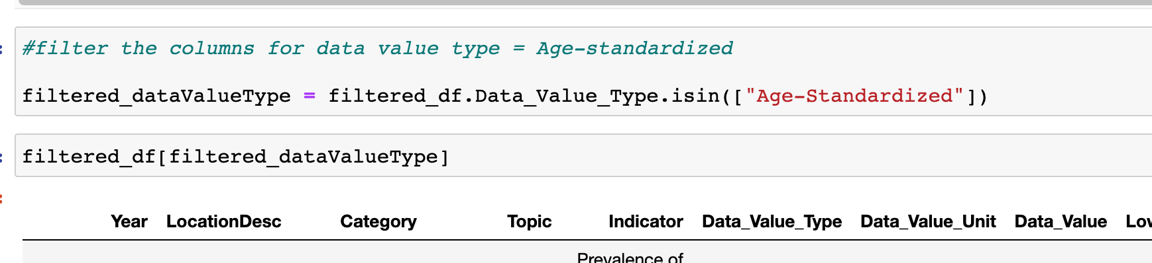
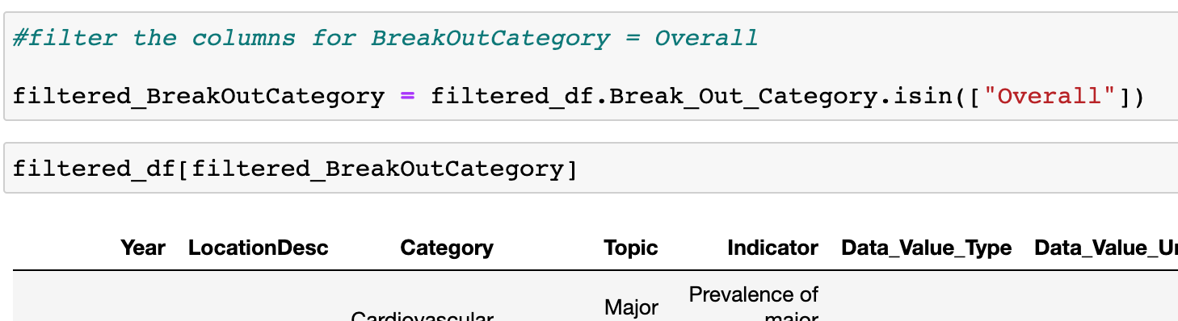
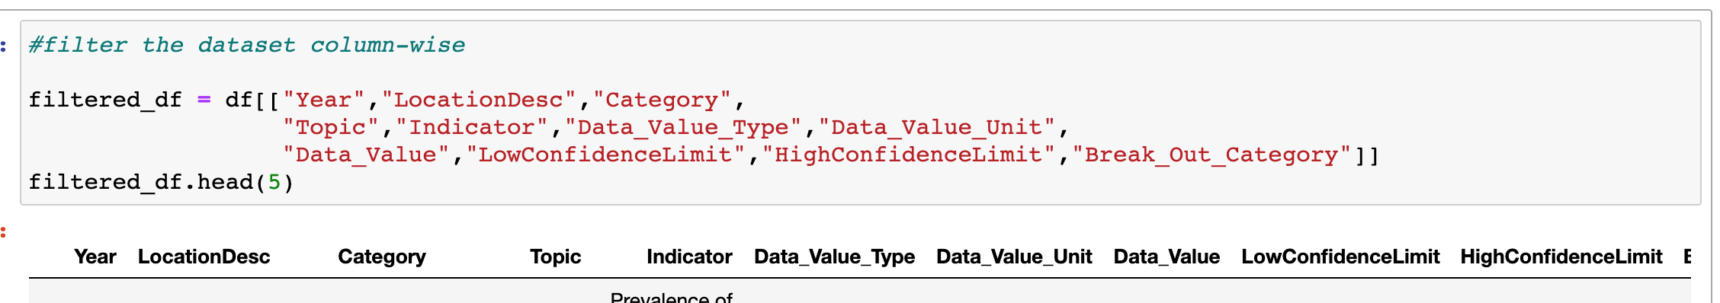
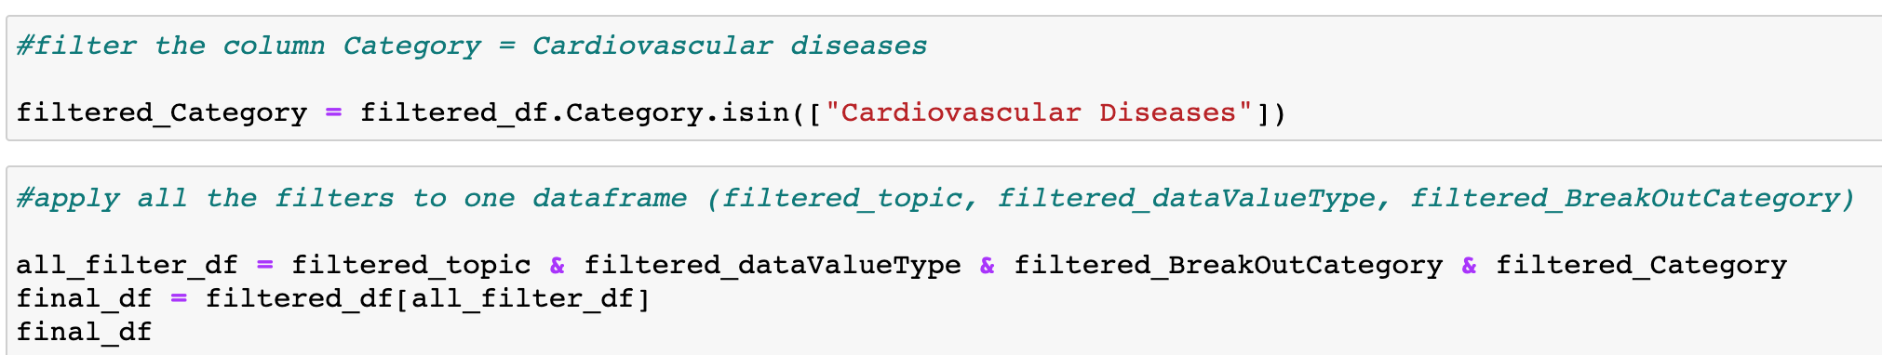
Preprocessing the dataset

Slide 5
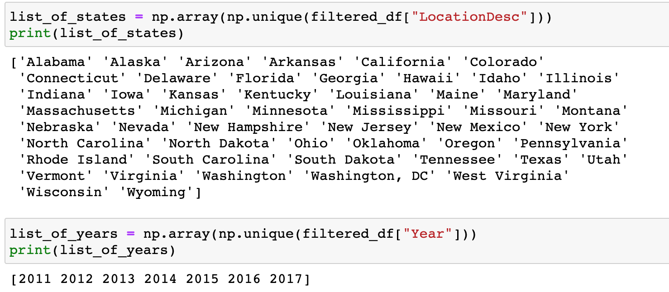
Create a list of states and years for iteration

Slide 6
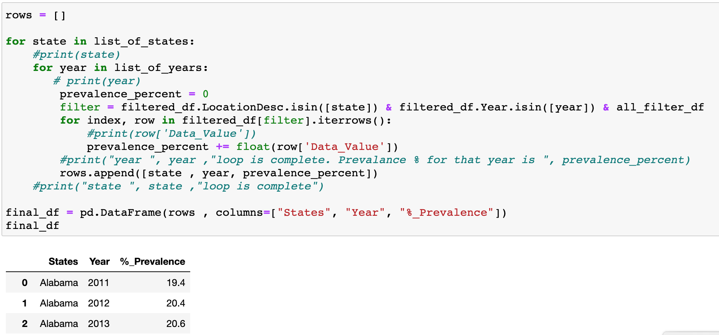
Iterate through all the rows and create a dataframe of all the states with its respective Percentage prevalence of heart disease each year

Slide 7
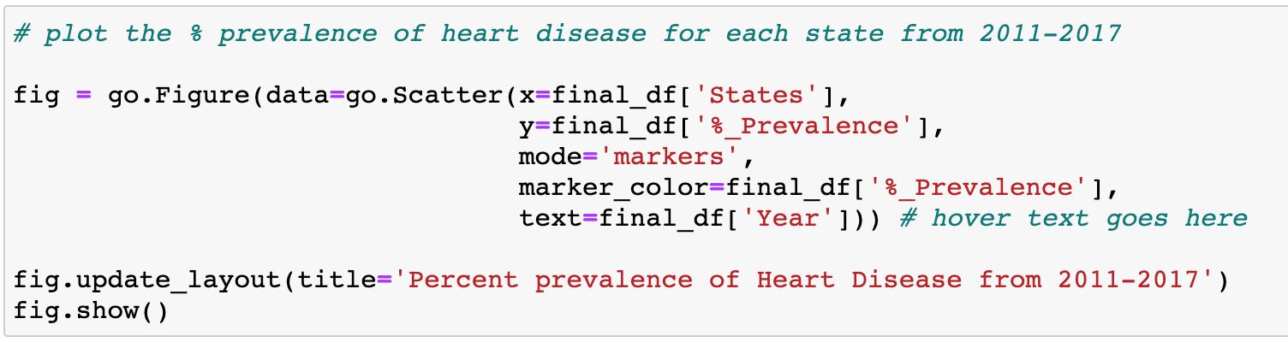
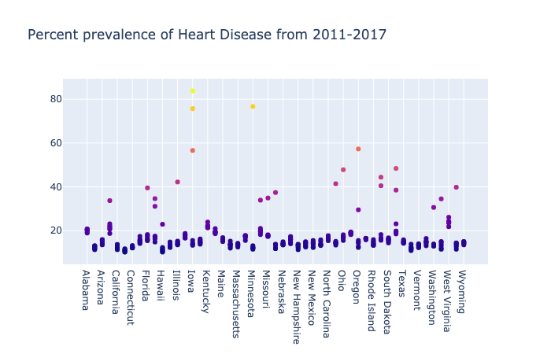
Plot the percentage prevalence of heart disease from 2011-2017 for each state

Slide 8
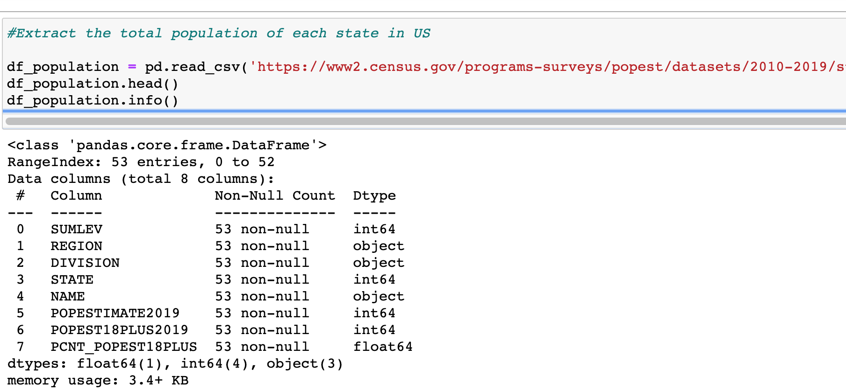
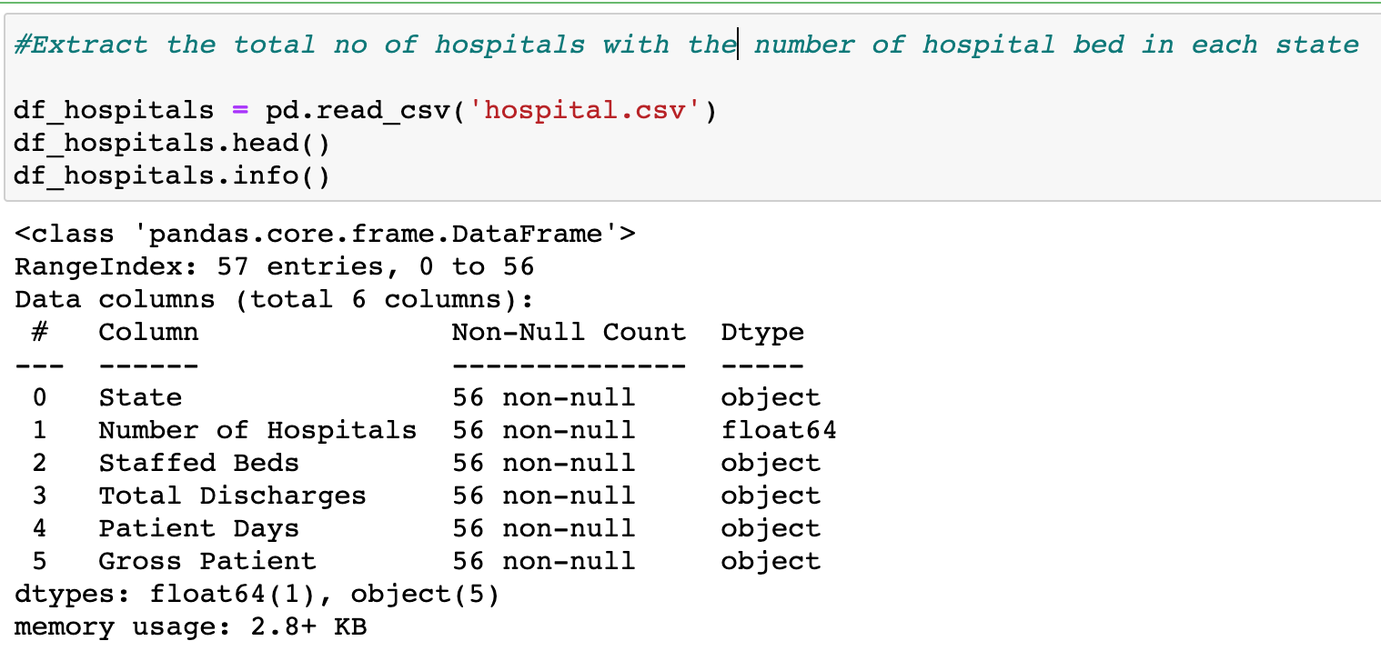
Extract the total population and the no. of staffed hospital beds in each state

Slide 9
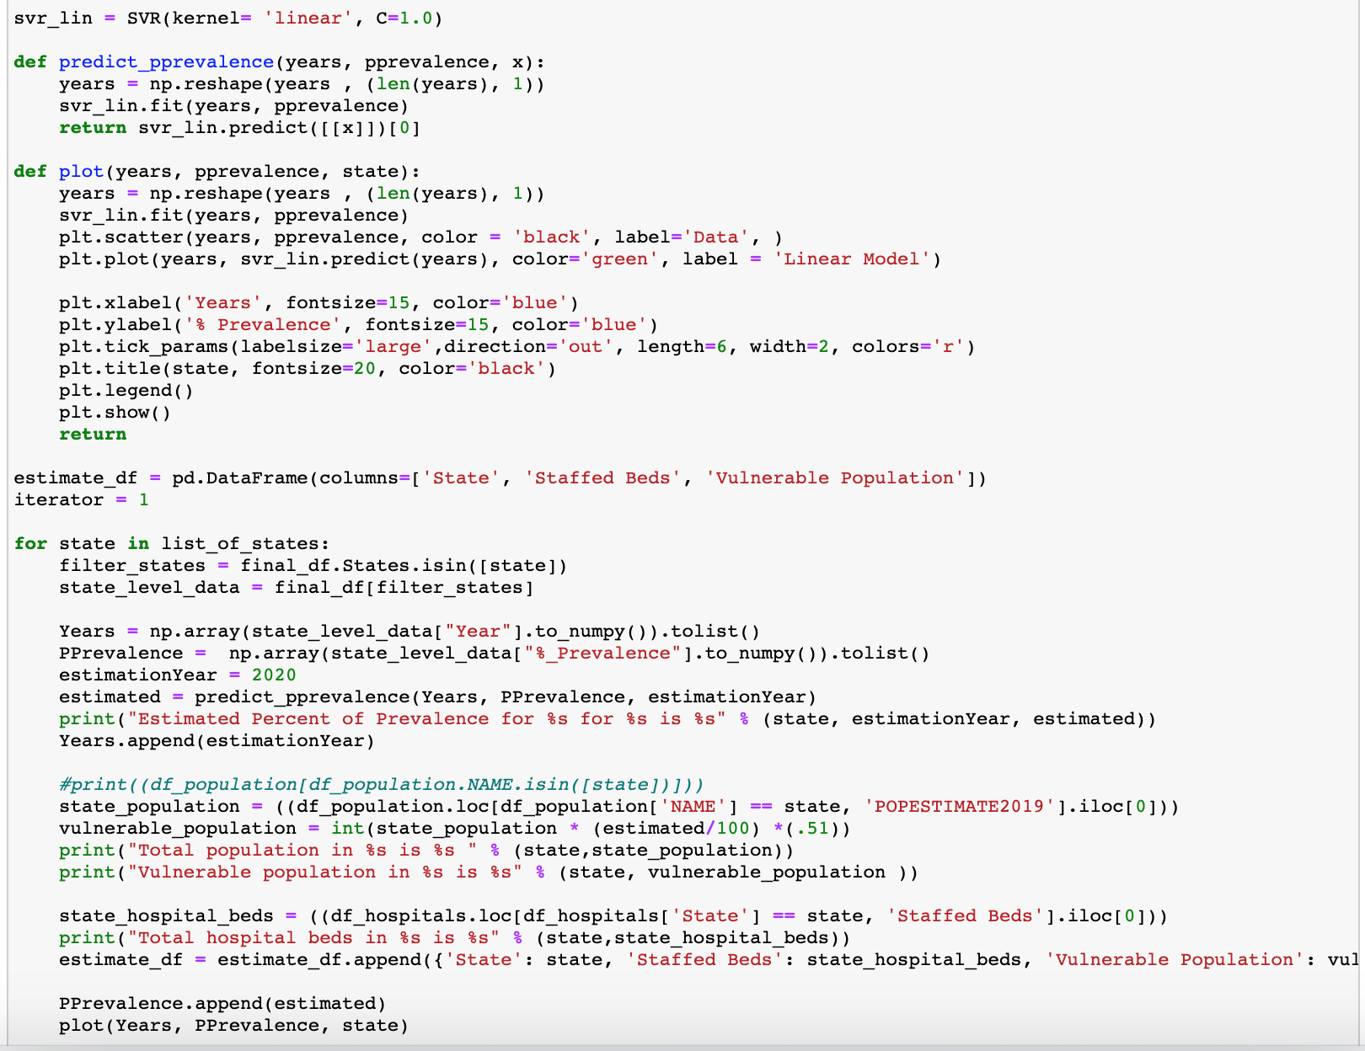
Plot linear regression for each state from 2011-2017 and predict the percentage prevalence for 2020

Slide 10
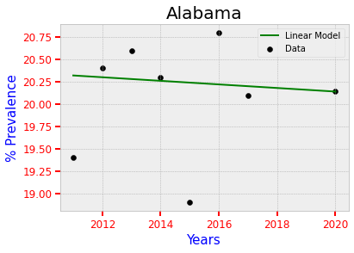
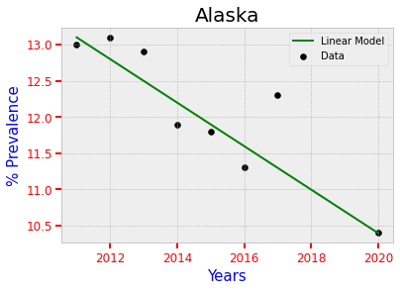
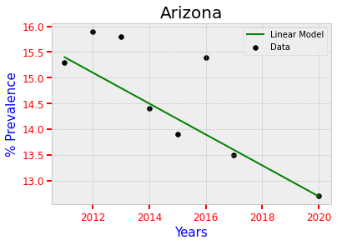
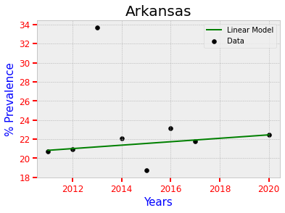
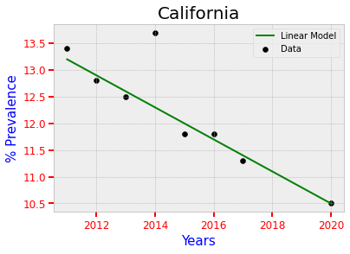
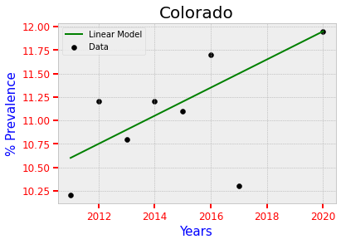
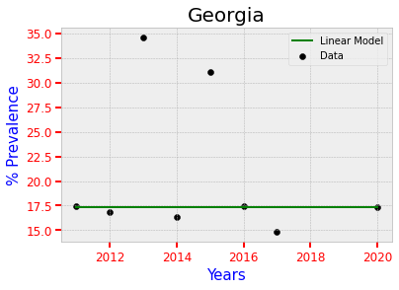
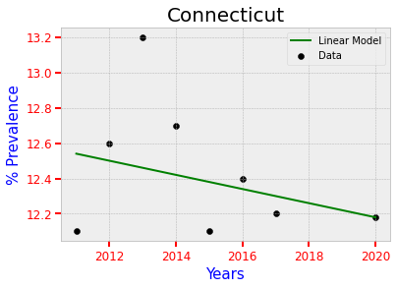
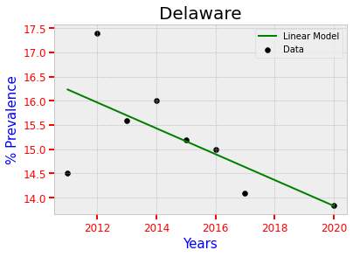
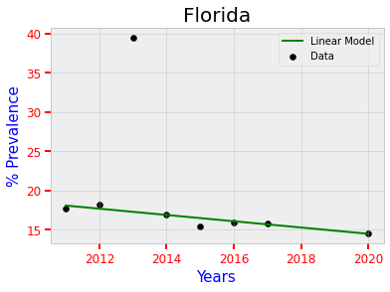
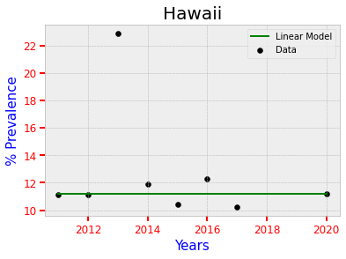
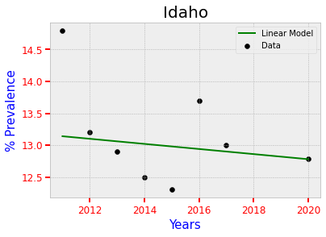

Slide 11
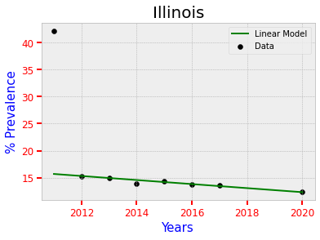
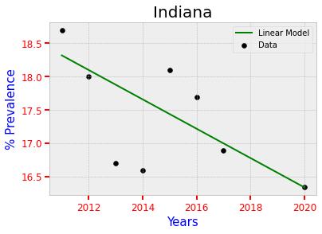
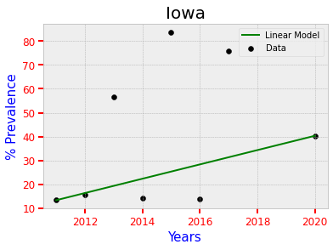
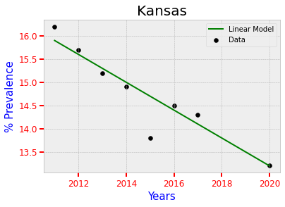
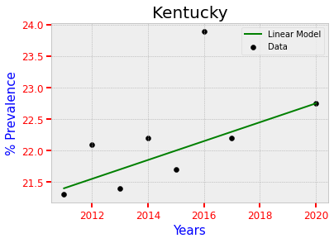
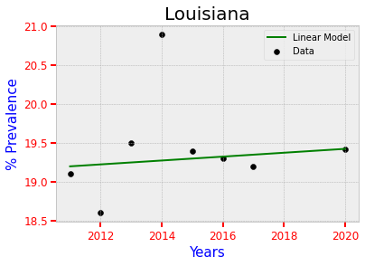
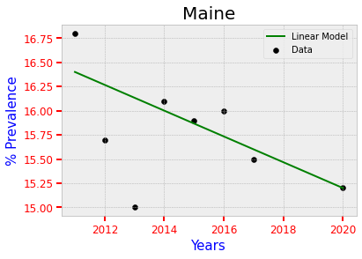
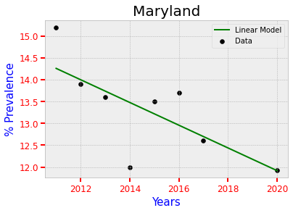
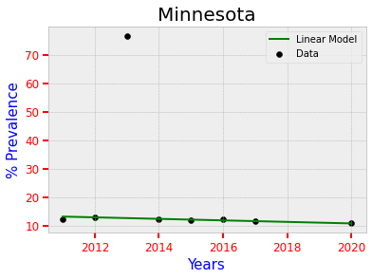
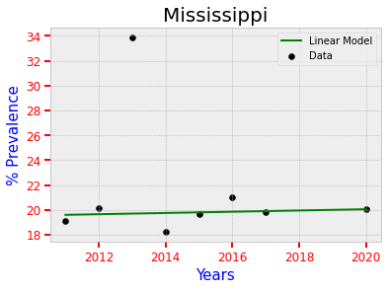
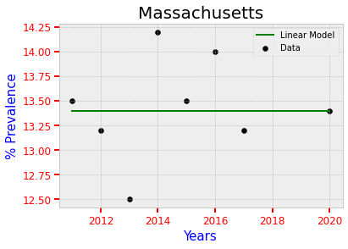
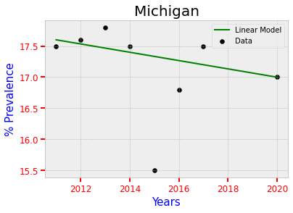

Slide 12
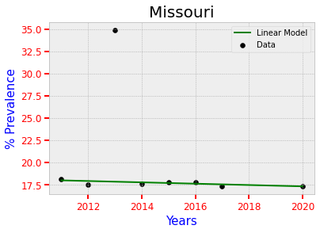
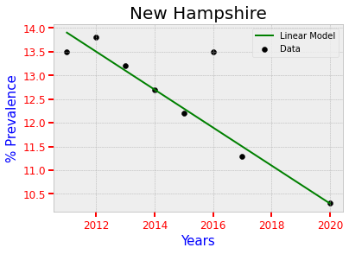
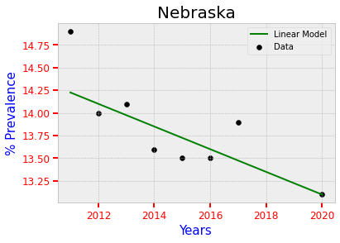
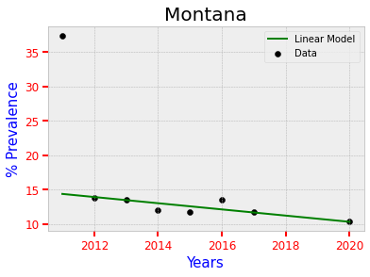
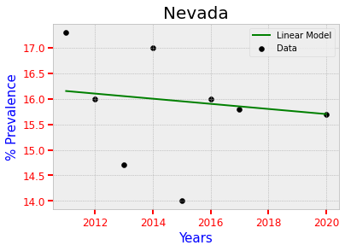
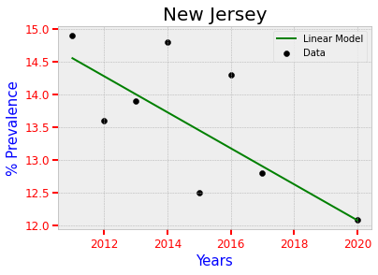
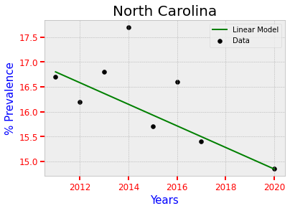

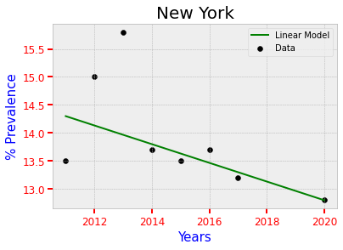
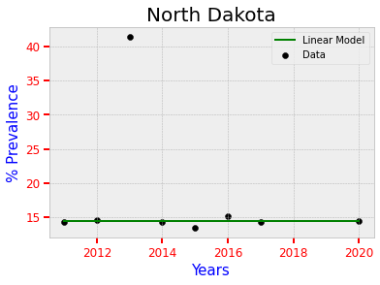

Slide 13
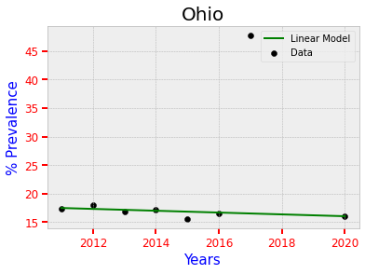
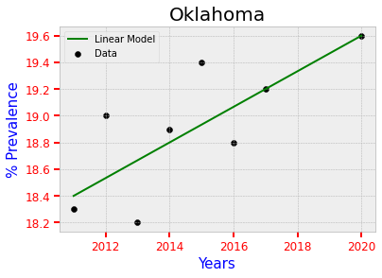
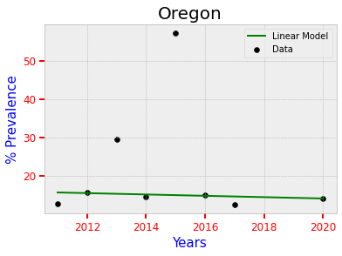











Slide 14

Create a dataframe with all the states, respective staffed beds and covid-19 vulnerable population

Slide 15


Plot a state-wise comparison graph with the maximum number of vulnerable population

Slide 16


Plot a heatmap to show the states that are most vulnerable

Slide 17

Export the final dataset created to clean it

Slide 18

K-Mean clustering analysis to show the number of clusters that can be created and plot the elbow graph

Slide 19

Plot the cluster of states with high medium and low vulnerability

Slide 20
THANK YOU!!

